Slide 1
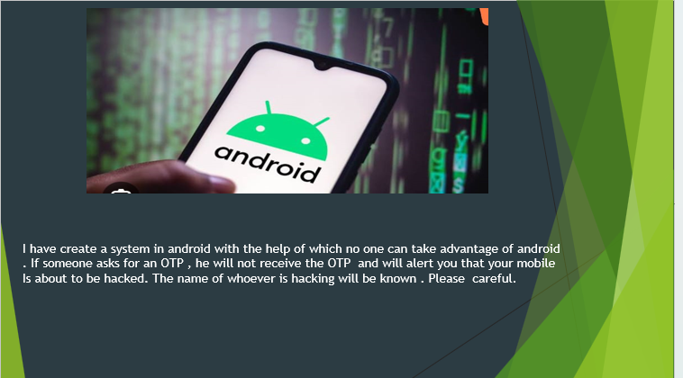
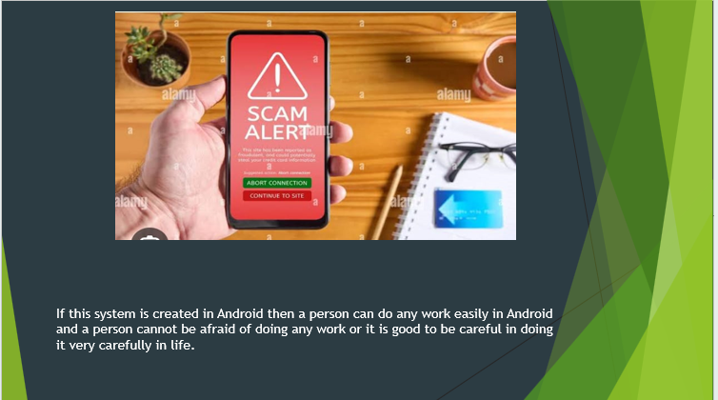



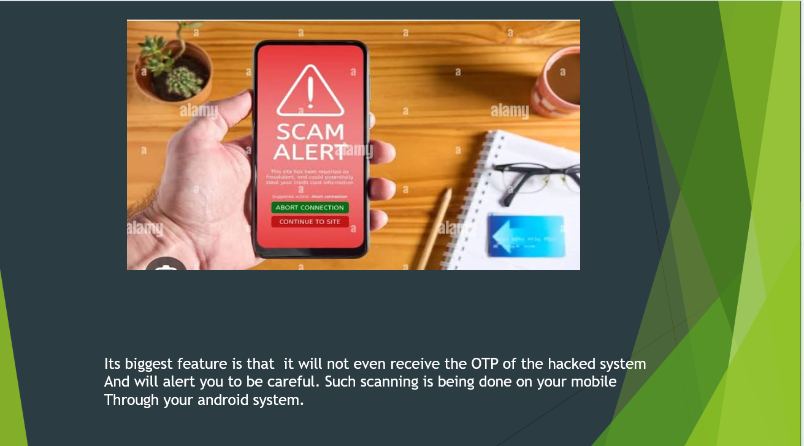

ANDROID SCAM
Raushan kumar(Group Leader)
Vipul Kumar
Ajit Kumar
Munna kumar

